Slide 1
Cash Scanner
Artificial Intelligence term project Aleksandar Panayotov Rumen Paletov Dian Nikolov

Slide 2
Purpose?
Take a pic of coins
Recognize the coins
Understand the value of different coins
Show statistics
Calculate total value of all coins photographed
Android platform

Slide 3
Solution
Take a photo
Scale
Grayscale
Edge detection
Hough transforms (for circles)
MR8 filters for each circle
K-means
Histogram comparison
Classification of circles
Final results!

Slide 4
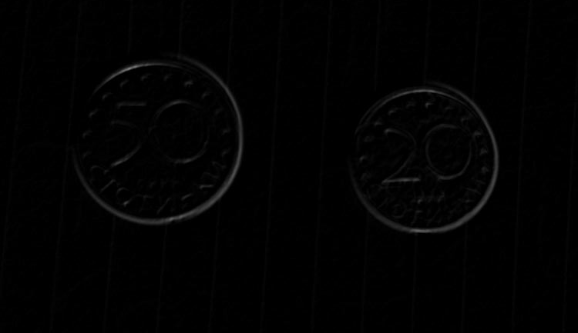
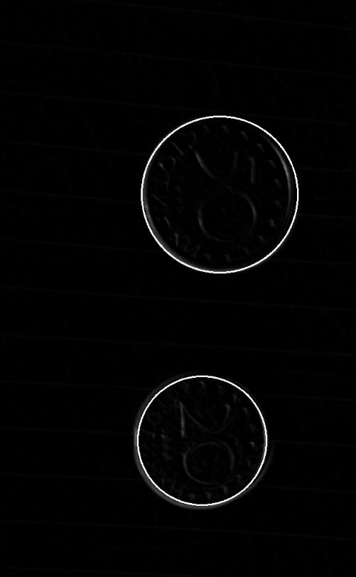
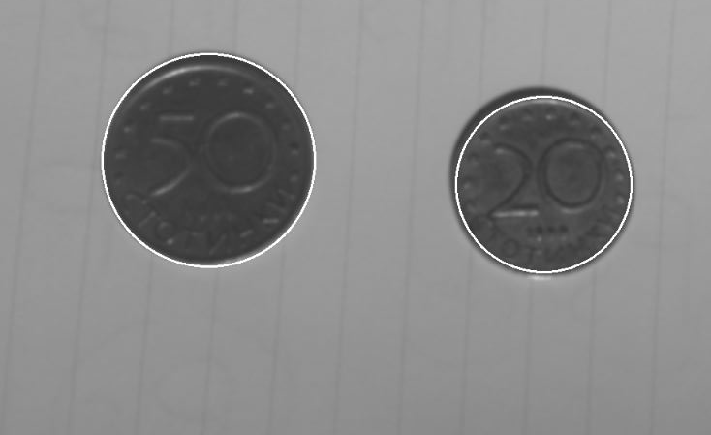
Example
Sobel identifies edges
Hough transforms recognizes coins
Original image result overlay

Slide 5
In details
Why Sobel and not Canny edge
Why Hough transforms
How are we classifying found circles as specific coins

Slide 6
Problems
Algorithm adjustments
Filtering problems
Insufficient research information
Texture markedness and detail

Slide 7
Results and analysis
We can positively differentiate coins from other (round) objects
Successful processing, however, depends highly on:
Quality of input image
Texture markedness
Texture level of detail - there are subtle differences between different classes of coins that must be recognized

Slide 8
Live Demo

Slide 9
Thank you!

